Slide 1
MODULE 3

Slide 2
Module 3
PHP Language Structure: Introduction- Building blocks of PHP
Variables, Data Types -Converting between Data Types-
Operators and Expressions
simple PHP program
Flow Control functions
Control statements
Working with Functions
Initializing and Manipulating Arrays
Objects- String Comparisons-
String processing with Regular Expression

Slide 3
PHP Language Structure
Rasmus Lerdorf developed PHP in 1994.
A PHP script is executed on the server, and the plain HTML result is sent back to the browser.
A PHP script can be placed anywhere in the document.
A PHP script starts with <?php and ends with ?>
The default file extension for PHP files is ".php".

Slide 4
A PHP file normally contains HTML tags, and some PHP scripting code.
PHP code is executed on the server, generating HTML which is then sent to the client.
The client would receive the results of running that script, but would not know what the underlying code was.
PHP is compatible with almost all servers used today (Apache, IIS, etc.). PHP is easy to learn and runs efficiently on the server side
PHP is FREE to download from : www.php.net

Slide 5
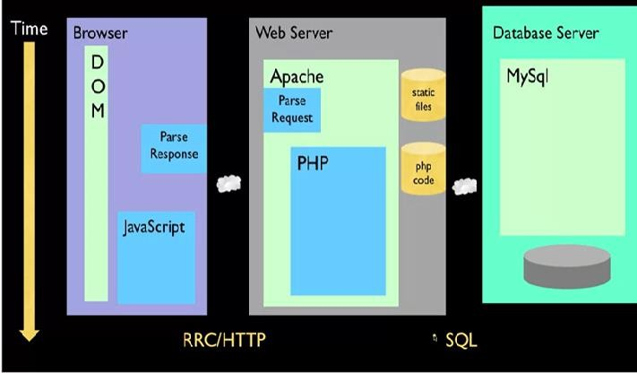
Introduction to PHP

Slide 6
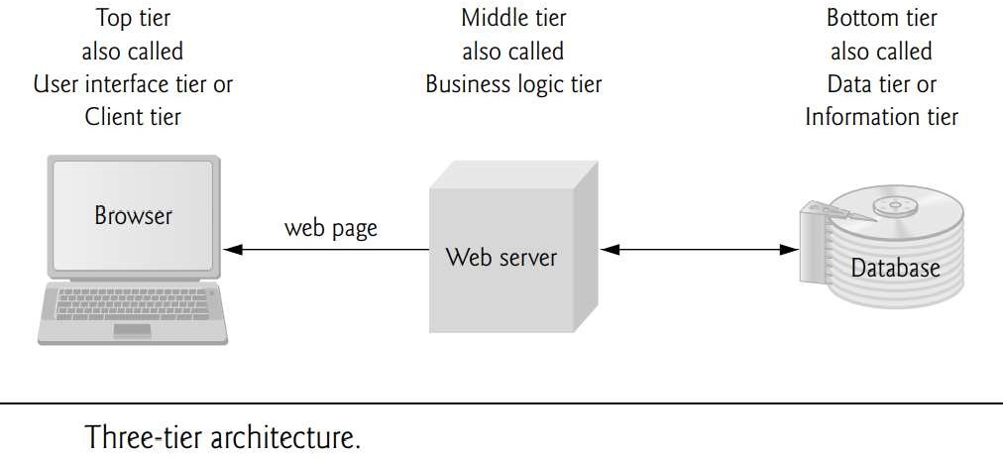
Three-tier web-based application

Slide 7
Three-tier web-based application
The bottom tier (also called the data tier or the information tier) maintains the application’s data.
This tier typically stores data in a relational database management system (RDBMS)
The middle tier implements business logic, controller logic and presentation logic to control interactions between the application’s clients and its data.
The middle tier acts as an intermediary between data in the information tier and the application’s clients.

Slide 8
The middle-tier controller logic processes client requests (such as requests to view a product catalog) and retrieves data from the database.
The top tier, or client tier, is the application’s user interface, which gathers input and displays output.
Users interact directly with the application through the user interface, which is typically a web browser or a mobile device.

Slide 9
Client-Side Scripting versus Server-Side Scripting
Client-side scripting with JavaScript can be used to validate user input, to interact with the browser, to enhance web pages, and to add client/server communication between a browser and a web server.
Client-side scripting does have limitations, such as browser dependency; the browser or scripting host must support the scripting language and capabilities.
client-side scripts can be viewed by the client using the browser’s source-viewing capability

Slide 10
server-side scripts, often generate custom responses for clients
Server-side scripting languages have a wider range of programmatic capabilities than their client-side equivalents.
Server-side scripts also have access to server-side software that extends server functionality—Microsoft web servers use ISAPI (Internet Server Application Program Interface) extensions and Apache HTTP Servers use modules.

Slide 11
Accessing Web Server
To request documents from web servers, users must know the hostnames on which the web server software resides.
Users can request documents from local web servers (i.e., ones residing on users’ machines) or remote web servers (i.e., ones residing on different machines).
Local web servers can be accessed through your computer’s name or through the name localhost
localhost—a hostname that references the local machine and normally translates to the IP address 127.0.0.1 (known as the loopback address).

Slide 12
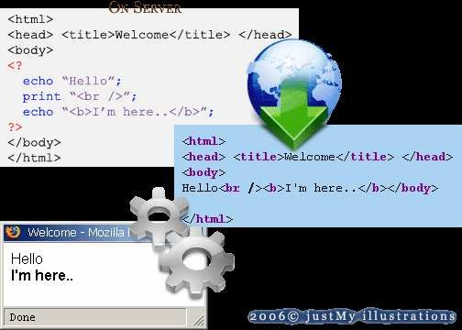
Installing to PHP

Slide 13
XAMPP integrated installer for Apache, MySQL and PHP is available for Windows, Mac OS X and Linux
On windows, you can download and install WAMP.
With one installation and you get an Apache webserver, database server and php.
http://www.wampserver.com
On mac, you can download and install MAMP.
http://www.mamp.info/en/index.html

Slide 14
PHP: “Hypertext Preprocessor”
Originally, PHP was an acronym for Personal Home Page
open source general-purpose scripting language
web development tool (not case sensitive)and can be embedded into HTML
File ends in .php—
Separated in files with the <?php ?> tag
php commands can make up an entire file, or can be contained in html.

Slide 15
Program lines end in ";" or you get an error
PHP scripts are executed on the server and is a case sensitive language . but PHP function names are case in-sensitive
PHP supports many databases (MySQL, Informix, Oracle, Sybase, Solid, PostgreSQL, Generic ODBC, etc.)
PHP runs on different platforms (Windows, Linux, Unix, etc.)

Slide 16
Building blocks of PHP
Variables
Data Types
Operators and Expressions
Constants

Slide 17
Variable
All variable names in PHP begin with dollar signs ($)
a letter or an underscore followed by any number (including zero) of letters, digits, or underscores.
PHP variable names are case sensitive.
Assigned by value
$foo = "Bob"; $bar = $foo;
Some are preassigned, server and env vars
For example, there are PHP vars, eg. PHP_SELF, HTTP_GET_VARS

Slide 18
Line 5 outputs the value of variable $name by calling function print. The value of $name is printed, not the string "$name".
When a variable is encountered inside a doublequoted ("") string, PHP interpolates the variable
All operations of this type execute on the server before the HTML5 document is sent to the client
PHP variables are loosely typed—they can contain different types of data (e.g., integers, doubles or strings) at different time.

Slide 19
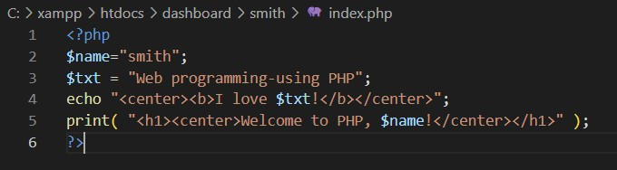
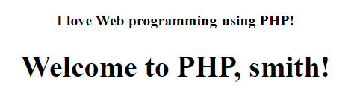

Slide 20
Global Variables
In PHP global variables must be declared global inside a function if they are going to be used in that function

Slide 21
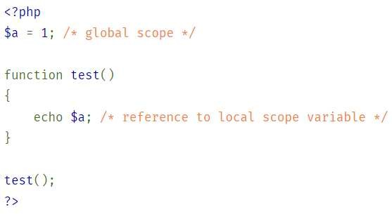
The above script will output 3. By declaring $a and $b global within the function, all references to either variable will refer to the global version. There is no limit to the
number of global variables that can be manipulated by a function.

Slide 22
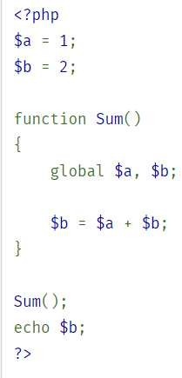

Slide 23
Building blocks of PHP
Super Global Variables
Super global variables are built-in variables that are always available in all scopes.

Slide 24
Super Global Variables
GLOBALS
$_SERVER
$_REQUEST
$_POST
$_GET $_ENV
$_COOKIE
$_SESSION

Slide 25
second way to access variables from the global scope is to use the special PHP- defined $GLOBALS array
The $GLOBALS array is an associative array with the name of the global variable being the key and the contents of that variable being the value of the array element.
$b is a variable present within the $GLOBALS array, it is also accessible from outside the function!

Slide 26
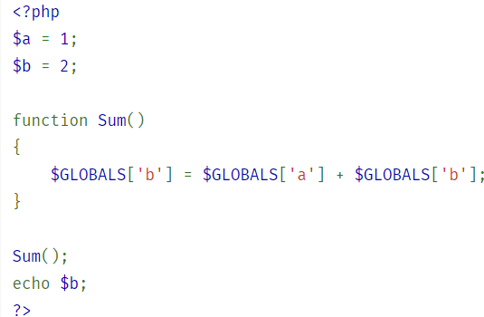

Slide 27
$GLOBALS- PHP super global variable which is used to access global variables from anywhere in the PHP script
$_SERVER is a PHP super global variable which holds information about headers, paths, and script locations.
$_REQUEST is a PHP super global variable which is used to collect data after submitting an HTML form.

Slide 28
$_POST is a PHP super global variable which is used to collect form data after submitting an HTML form with method="post". $_POST is also widely used to pass variables.
$_GET is a PHP super global variable which is used to collect form data after submitting an HTML form with method="get".$_GET can also collect data sent in the URL.

Slide 29
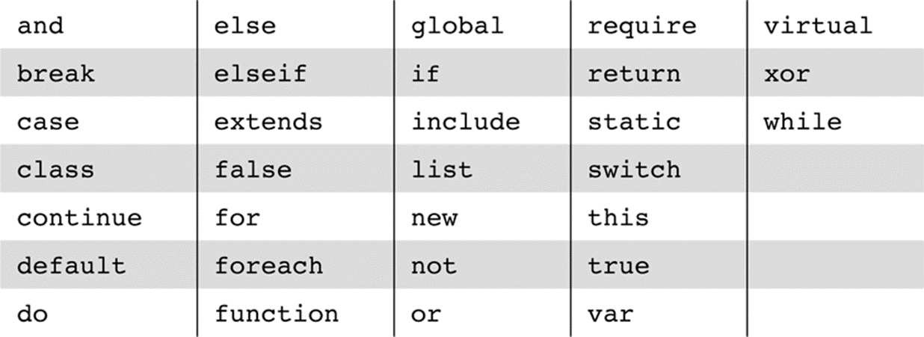
RESERVED WORDS

Slide 30
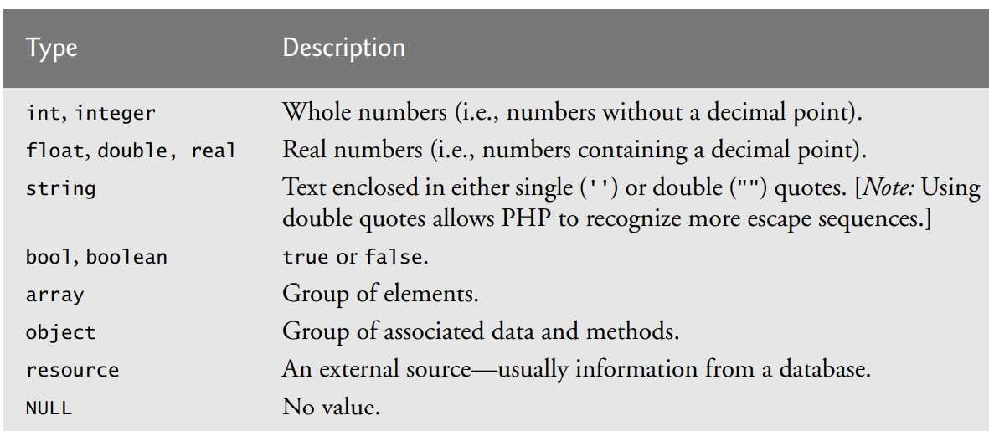
Data Types

Slide 31
PHP has four scalar types:
Boolean, integer, double, and string;
Two compound types,
array and object;
and two special types, resource and NULL
Integer Type
PHP has a single integer type, named integer. (corresponds to the long type of C)
In most cases, this is 32 bits, or a bit less (not fewer) than ten decimal digits.
Double Type

Slide 32
PHP's double type corresponds to the double type of C and its successors.
Double literals can include a decimal point, an exponent, or both.
The exponent has an E or an e

Slide 33
String Type
Characters in PHP are single bytes. no character type.
A single character data value is represented as a string of length 1.
String literals with either single (') or double quotes (")
In single-quoted string literals, escape sequences, such as \n, are not recognized and the values of embedded variables are not substituted
‘The sum is :$sum’ exactly as it is typed.

Slide 34
In double-quoted string literals, escape sequences are recognized, and embedded variables are replaced by their current values.
$sum=10;
print “The sum : $sum”;
o/p :The sum : 10

Slide 35
Boolean Type
The only two possible values for the Boolean type are TRUE and FALSE, both of which are case insensitive.
It is used in control structure like the testing portion of an if statement.
If an integer expression is used in Boolean context, it evaluates to FALSE if it is zero; otherwise, it is TRUE.
If a string expression is used in Boolean context, it evaluates to FALSE if it is either the empty string or the string "0"; otherwise, it is TRUE.
Ex: $var = true;

Slide 36
<?php
$height=100;
$width=50;
if ($width == 0)
{
echo "The width needs to be a non-zero number";
}
?>

Slide 37
PHP has several useful functions for determining the type of a variable.
is_array() True if variable is an array.
is_bool() True if variable is a bool.
is_float(), is_double(), is_real() True if variable is a float.
is_int(), is_integer(), is_long() True if variable is an integer.
is_null() True if variable is set to null.
is_numeric() True if variable is a number or numeric string.
is_scalar() True if variable is an int, float, string, or bool.
is_object() True if variable is an object.
is_resource() True if variable is a resource.
is_string() True if variable is a string.

Slide 38
PHP includes both implicit and explicit type conversions.
Implicit type conversions are called coercions
The context can cause a coercion of the type of the value of the expression.
Whenever a numeric value appears in string context, the numeric value is coerced to a string.
whenever a string value appears in numeric context, the string value is coerced to a numeric value.

Slide 39
If the string contains a period, an e, or an E, it is converted to double; otherwise, it is converted to an integer.
When a double is converted to an integer, the fractional part is dropped; rounding is not done

Slide 40
Changing data types
Explicit type conversions can be specified in three ways.
Using the syntax of C, an expression can be cast to a different type.
The cast is a type name in parentheses preceding the expression.
For example, if the value of $sum is 4 . 777,
the following produces 4:
(int)$sum

Slide 41
Another way to specify explicit type conversion is to use one of the functions
intval(), doubleval(), or strval().
For example, if $sum is still 4.77 7, the following call returns 4:
intval($sum)

Slide 42
The third way to specify an explicit type conversion is the settype() function, which takes two parameters
: a variable and a string that specifies a type name.
For example, if $sum is still 4 . 777,
the following statement converts the value of $sum to 4 and its type to integer:
settype($sum, "integer");

Slide 43
The settype() function converts a variable to a specific type.
Syntax: settype(variable, type);
<?php
$a = "32"; // string
settype($a, "integer"); // $a is now integer
$b = 32; // integer
settype($b, "string"); // $b is now string
$c = true; // boolean
settype($c, "integer"); // $c is now integer (1)
>?

Slide 44
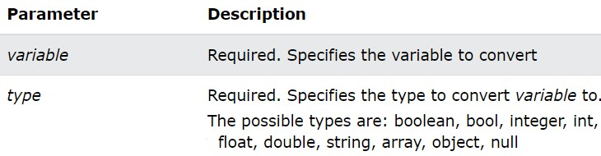

Slide 45
Changing data types by casting
We can cast following data type variable in PHP
(int), (integer) - cast to integer
(bool), (boolean) - cast to boolean
(float), (double), (real) - cast to float
(string) - cast to string
(array) - cast to array
(object) - cast to object
(unset) - cast to NULL (PHP 5)

Slide 46
Operators &expressions
PHP has the usual (for C-based programming languages) collection of arithmetic operators (+, -,*, /, %, ++, and --)
If either operand is a double, the operation is double and a double result is produced.
Operators are used to perform operations on variables and values.
PHP divides the operators in the following groups:
Arithmetic operators

Slide 47
Assignment operators
Comparison operators
Increment/Decrement operators
Logical operators
String operators
Array operators
Conditional assignment operators

Slide 48
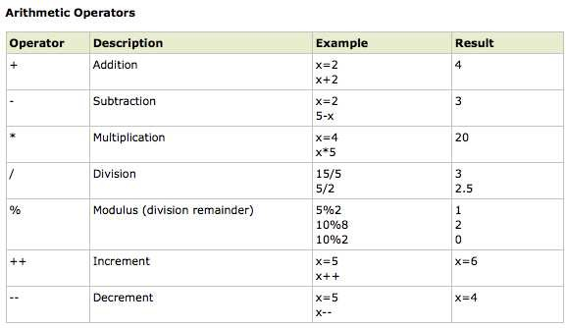

Slide 49
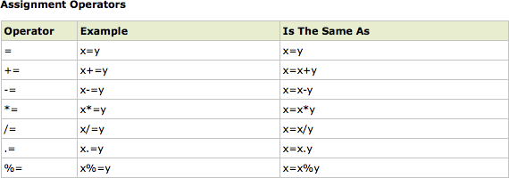

Slide 50
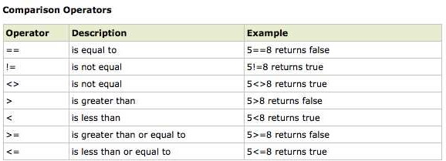

Slide 51
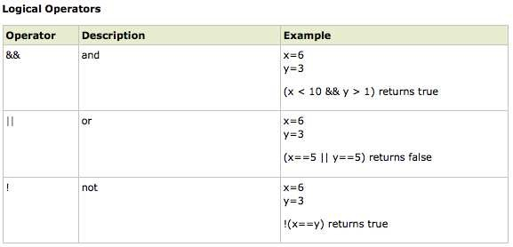

Slide 52
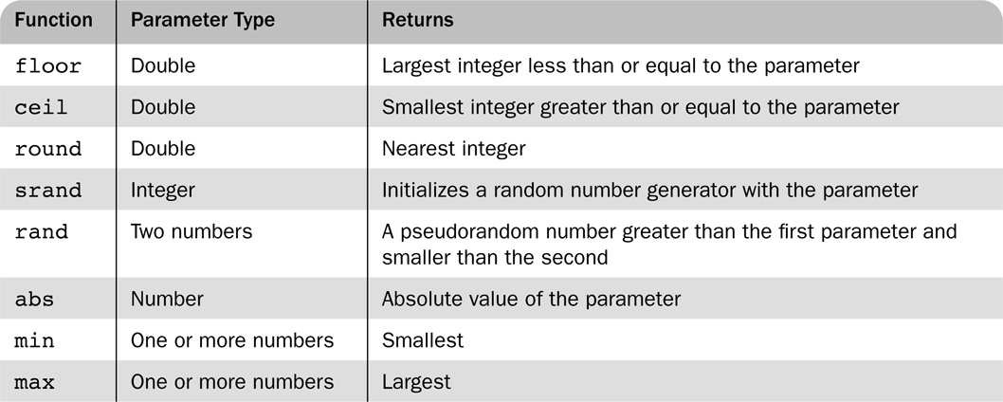

Slide 53
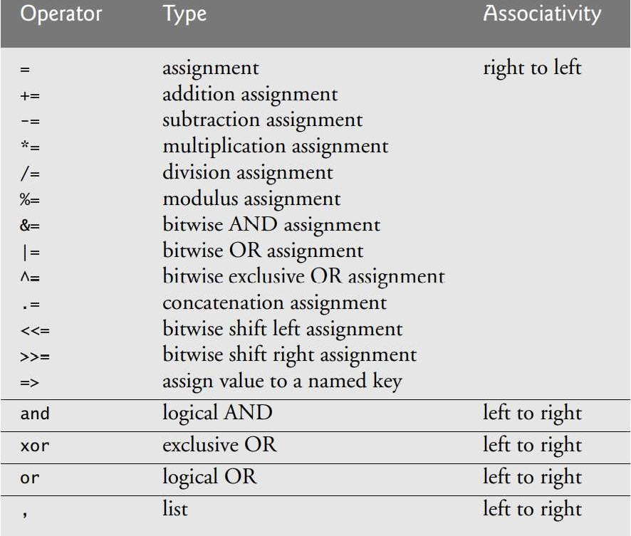

Slide 54
The floor() function rounds a number DOWN to the nearest integer, if necessary.
<?php
echo(floor(0.60) . "<br>"); //0
echo(floor(0.40) . "<br>");//0
echo(floor(5) . "<br>");//5

Slide 55
echo(floor(5.1) . "<br>");//5
echo(floor(-5.1) . "<br>");//-6
echo(floor(-5.9));//-6
echo (ceil(0.70)); //1
echo(ceil(-4.1));//-4
echo(ceil(6.2));//7
echo(round(0.70878, 2)); //0.71?>

Slide 56
ceil():To round a number UP to the nearest integer use the ceil() function.
round(): To round a floating-point number, use the round() function

Slide 57
rand()
The rand() function generates a random integer.
If you want a random integer between 10 and 100 (inclusive), use rand (10,100).

Slide 58
<!DOCTYPE html>
<html>
<body>
<?php
echo(rand() . "<br>");
echo(rand() . "<br>");
echo(rand(10,100));
?>
</body>
</html>

Slide 59
Constants
A constant is a name or an identifier for a simple value.
A constant value cannot change during the execution of the script.
By default, a constant is case-sensitive.
By convention, constant identifiers are always uppercase.
A constant name starts with a letter or underscore, followed by any number of letters, numbers, or underscores.
If you have defined a constant, it can never be changed or undefined.
To define a constant you have to use define() function and to retrieve the value of a constant, you have to simply specifying its name.

Slide 60
<?php
define("MINSIZE", 50);
echo MINSIZE;
echo constant("MINSIZE"); // same thing as the previous line?>

Slide 61
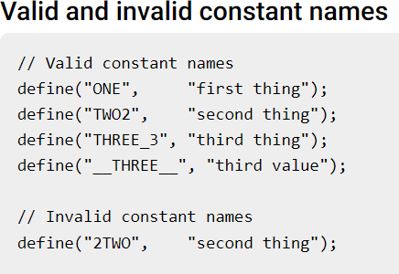

Slide 62
Only scalar data (boolean, integer, float and string) can be contained in constants.
Differences between constants and variables are
There is no need to write a dollar sign ($) before a constant, where as in Variable one has to write a dollar sign.

Slide 63
Constants cannot be defined by simple assignment,
They may only be defined using the define() function.
Constants may be defined and accessed anywhere without regard to variable scoping rules.
Once the Constants have been set, may not be redefined or undefined.

Slide 64
Echo and Print
echo and print are more or less the same.
They are both used to output data to the screen.
echo has no return value while print has a return value of 1 so it can be used in expressions.
echo can take multiple parameters (although such usage is rare) while print can take one argument.
echo is marginally faster than print.

Slide 65
<!DOCTYPE html >
<html>
<head>
<title> today.php </title> </head>
<body> <p>
<?php
print "<b>Welcome to my home page <br /> <br />";
print "Today is:</b>date("Y/m/d");
print "<br />";
?>
</p>
</body>
</html>

Slide 66
o/p
Welcome to my Home Page
Today is 2014/09/24

Slide 67
Flow Control statements in PHP
If statement can include any number of elseif clauses.
example of an if construct:
if ($day == "Saturday" || $day == "Sunday")
{$today = "weekend”
};
else
{$today = "weekday";
}

Slide 68
If($num>0)
$pcount++;
elseif($num<0)
$ncount++;
else
print “Zero”;

Slide 69
switch (n)
{ case label1:
code to be executed if n=label1;
break;
case label2:
code to be executed if n=label2;
break;

Slide 70
case label3:
code to be executed if n=label3;
break;
...
default:
code to be executed if n is different from all labels; }

Slide 71
The while, for, and do-while statements of PHP are exactly like those of Java.
PHP also has a foreach statement

Slide 72
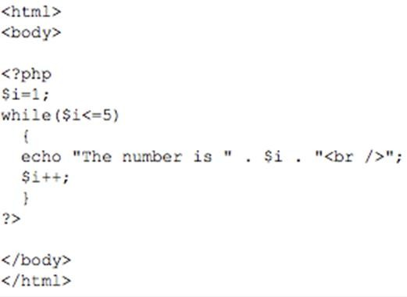

Slide 73
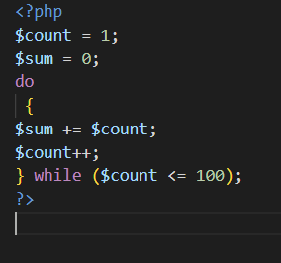

Slide 74
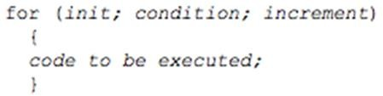

Slide 75
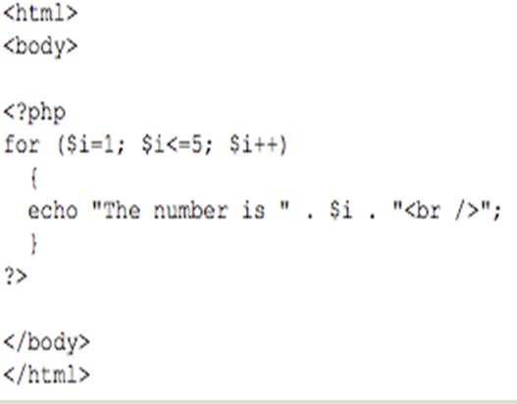

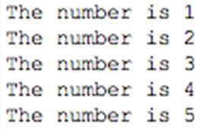

Slide 76
The break statement can be used to terminate the execution of a for, foreach, while, or do-while construct.
The continue statement is used in loop constructs to skip the remainder of the current iteration but continue execution at the beginning of the next.

Slide 77
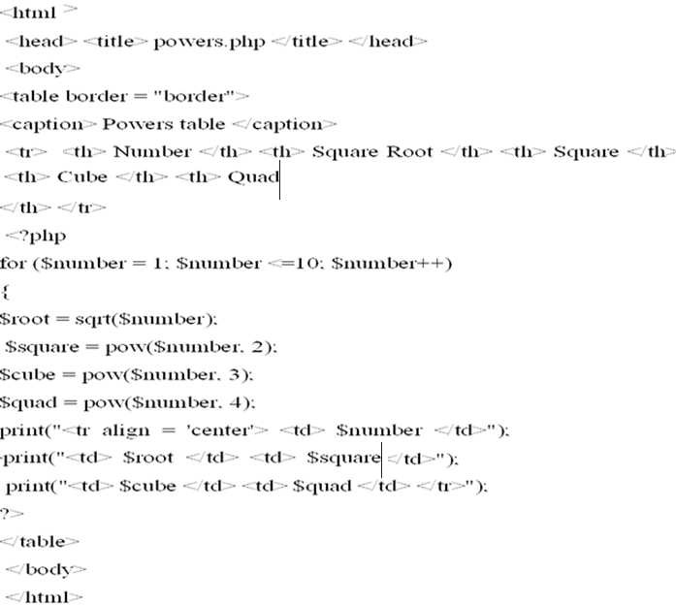

Slide 78
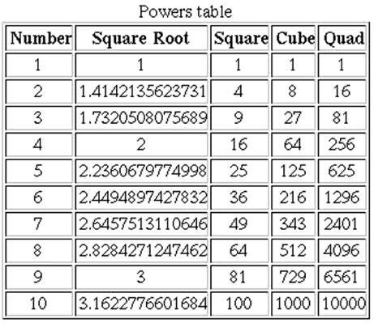

Slide 79
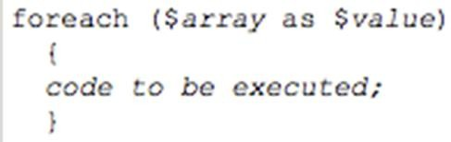

Slide 80
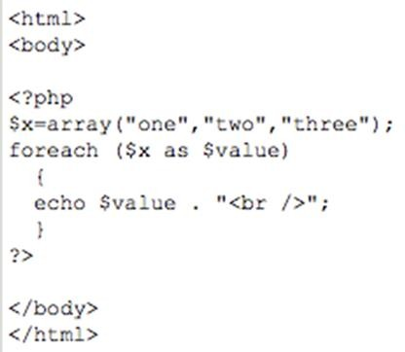

Slide 81
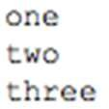

Slide 82
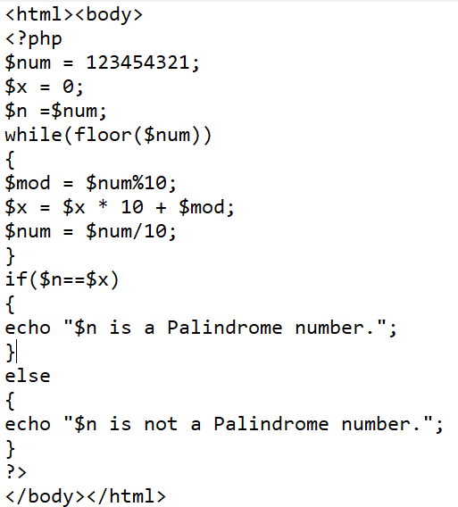

Slide 83
Arrays in PHP
PHP provides the capability to store data in arrays.
Arrays are divided into elements that behave as individual variables.
Array names, begin with the $ symbol
Individual array elements are accessed by following the array’s variable name with an index enclosed in square brackets ([]).
If a value is assigned to an array element of an array that does not exist, then the array is created.

Slide 84
assigning a value to an element where the index is omitted appends a new element to the end of the array
In PHP, there are three kind of arrays:
Numeric array - An array with a numeric index
Associative array - An array where each ID key is associated with a value
Multidimensional array - An array containing one or more arrays

Slide 85
Creating numeric Arrays in PHP
A numeric array stores each array element with a numeric index.
There are two methods to create a numeric array.
2)second way to create an array is with the array construct.
In the following example the index is automatically assigned (the index starts at 0):

Slide 87
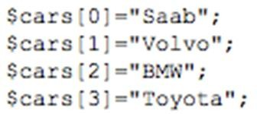

Slide 88
Creating Associative Arrays in PHP
With an associative array, each ID key is associated with a value.
When storing data about specific named values, a numerical array is not always the best way to do it.
With associative arrays we can use the values as keys and assign values to them

Slide 89
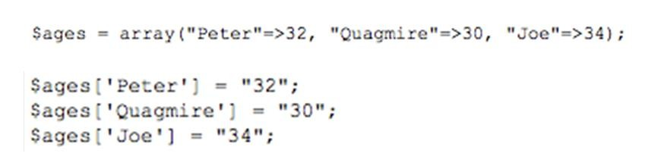
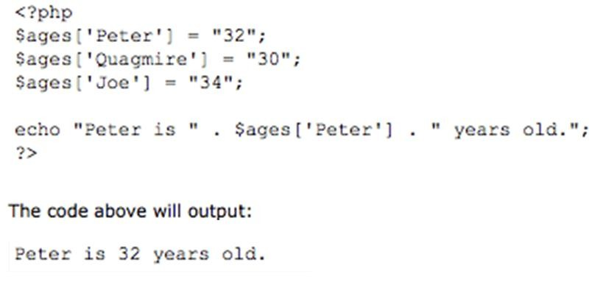

Slide 90
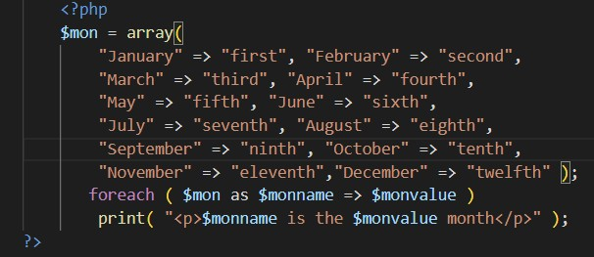

Slide 91
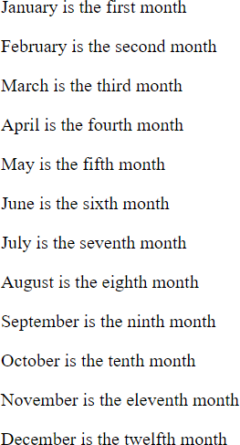

Slide 92
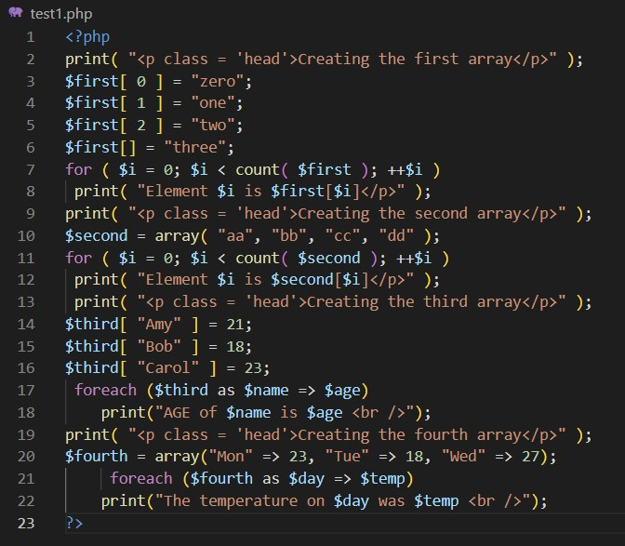

Slide 93
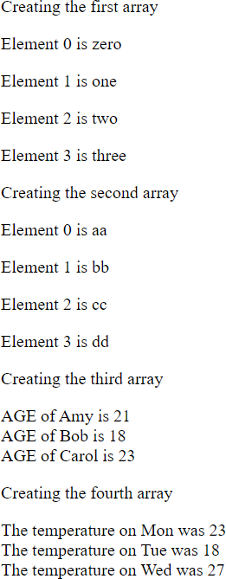

Slide 94
Functions dealing with Array
Unset
A whole array can be deleted with unset(), as with a scalar variable.
Individual elements of an array also can be removed with unset, as in
the following:
$list = array(2, 4, 6, 8);
unset($list[2]);
Now $list has three remaining elements with keys 0,1, and 3 and elements 2, 4, and 8.

Slide 95
The collection of keys and the collection of values of an array can be extracted with built-in functions.
The array_keys function takes an array as its parameter and returns an array of the keys of the given array.
The returned array uses 0, 1, and so forth as its keys.

Slide 96
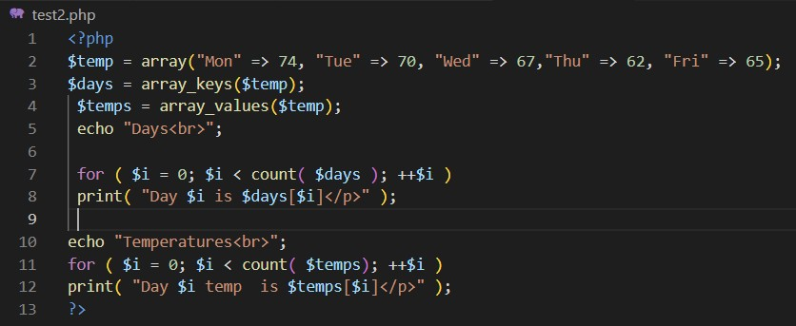

Slide 97
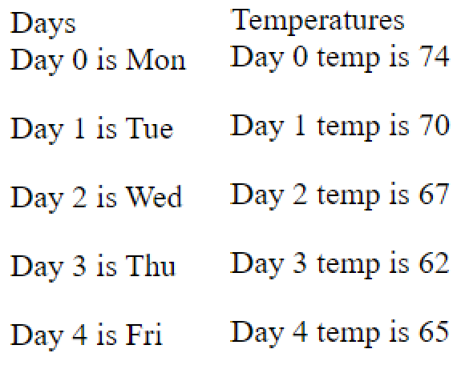

Slide 98
The existence of an element of a specific key can be determined with the array_key_exists function, which returns a Boolean value.
For example, consider the following:

Slide 99
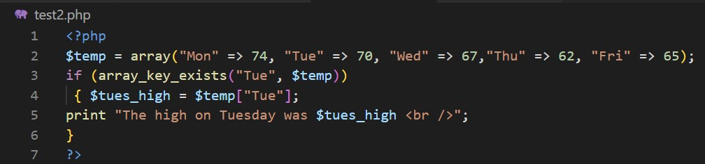

Slide 100
The is_array function is similar to the is_int function: It takes a variable as its parameter and returns
TRUE if the variable is an array, FALSE otherwise.

Slide 101
The in_ array function takes two parameters an expression and an array and returns TRUE if the value of the expression is a value in the array;
otherwise, it returns FALSE.

Slide 102
sizeof()
The number of elements in an array can be determined with the sizeof function.
For example, consider the following code:
$list = array("Bob", "Fred", "Alan", "Bozo");
$len = sizeof($list);
After executing this code, $len will be 4.

Slide 103
count() -counts the number of elements in an array;
sizeof() is an alias of count().
Given the array
$colors = array("blue", "black", "red", "green");
both count($colors); and sizeof($colors); return a value of 4

Slide 104
The explode function explodes a string into substrings and returns them in an array.
The delimiters of the substrings are defined by the first parameter to explode, which is a string; the second parameter is the string to be converted.
$str = “May god bless you all";
$words = explode(" ", $str);

Slide 105
$words creates an array which contains (“May", “god", “bless", “you", “all").
The implode function does the inverse of explode.
Given a separator character (or string) and an array, it concatenates the elements of the array together, using the given separator string between the elements, and returns the result as a string.

Slide 106
$words = array("Are", "you", “coming", "to“, ”India?”);
$str = implode(" ", $words);
$str has "Are you coming to India?"

Slide 107
The array_push and array_pop functions provide a simple way to implement a stack in an array.
The array_push function takes as its first parameter an array.
After this first parameter, there can be any number of additional parameters.
The values of all subsequent parameters are placed at the end of the array.

Slide 108
The array_push function returns the new number of elements in the array.

Slide 109
array_pop function takes a single parameter, the name of an array.
It removes the last element from the array and returns it.
The value NULL is returned if the array is empty.

Slide 110
array_unshift()—This function adds one or more elements to the beginning of an existing array

Slide 111
array_shift()—This function removes (and returns) the first element of an existing array,

Slide 112
array_merge()—This function combines two or more existing arrays.

Slide 113
To process Array use foreach statement
The foreach statement is designed to build loops that process all of the elements of an array.
This statement has two forms:
foreach (array as scalar_variable)loop body
foreach (array as key => value) loop body

Slide 114
In the first form, one of the array's values is set to the scalar variable for each iteration of the loop body.
Ex: $list=array(2,4,6,8);
foreach (Slist as $temp)
print("$temp <br />");
This code will produce the values of all of the elements of $list

Slide 115
The second form of foreach provides both the key and the value of each element of the array.
foreach (array as key => value) loop body
For example:
$lows = array("Mon" => 23, "Tue" => 18, "Wed" => 27);
foreach ($lows as $day => $temp)
print("The low temperature on $day was $temp <br />");

Slide 116
sort() - sort arrays in ascending order
rsort() - sort arrays in descending order
asort() - sort associative arrays in ascending order, according to the value
ksort() - sort associative arrays in ascending order, according to the key

Slide 117
<?php
$fruits = array("Orange", "Grapes", "Apple","Banana");
sort($fruits);
foreach($fruits as $x )
{
echo $x; echo "<br>";
}

Slide 118
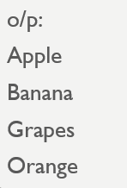

Slide 119
sort() - sort arrays in ascending order
rsort() - sort arrays in descending order

Slide 120
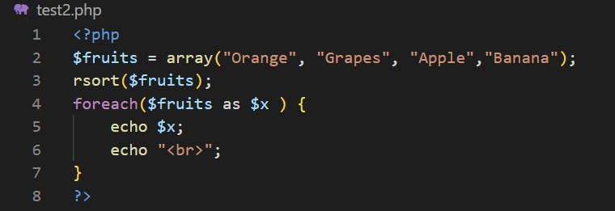

Slide 121


Slide 122
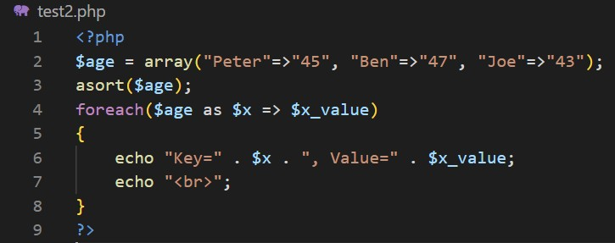
asort() - sort associative arrays in ascending order, according to the value.

Slide 123


Slide 124
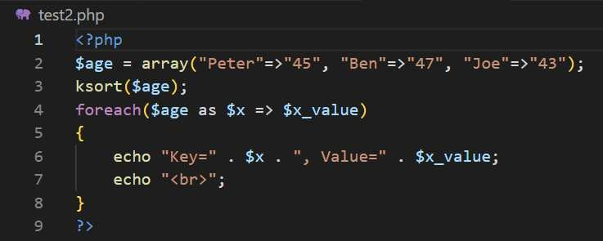
ksort() - sort associative arrays in ascending order, according to the key

Slide 125


Slide 126
The sort function, which takes an array as a parameter, sorts the values in the array, replacing the keys with the numeric keys, 0, 1, 2, ....
The array can have both string and numeric values.
The string values migrate to the beginning of the array in alphabetical order.
The numeric values follow in ascending order

Slide 127
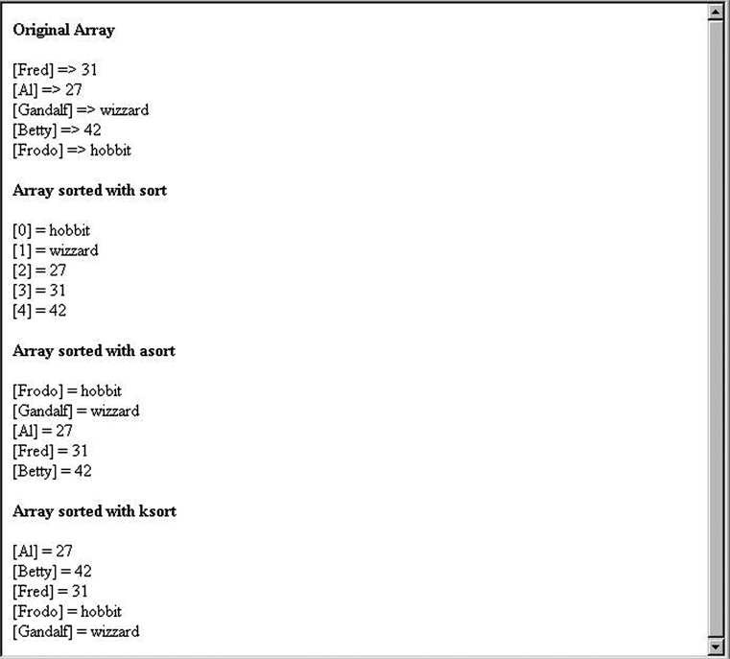

Slide 128
Arrays-Using array_search()
With the help of array_search() function, we can remove specific elements from an array.

Slide 129
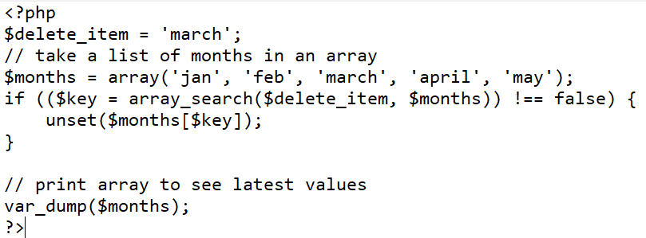

Slide 130
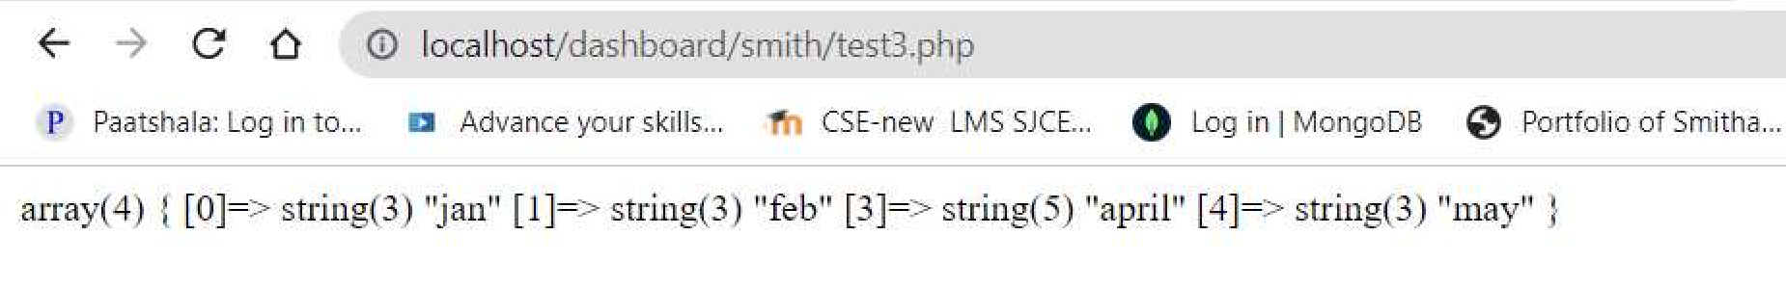
Page 73
Prof.Smitha Jacob, Department of Computer Science and Engineering, SJCET Palai

Slide 131
Arrays-Using array_diff()
With the help of array_diff() function, we also can remove specific elements from an array.

Slide 132
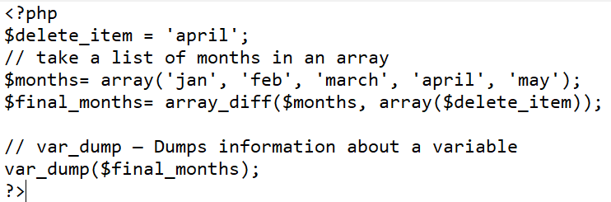

Slide 133
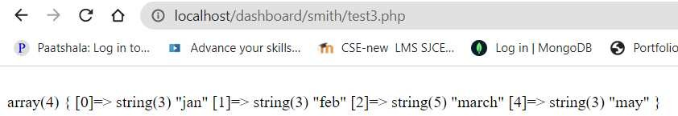

Slide 134
You need to find whether an array is subset of another array.
Let us suppose that there are two arrays.
First array is large which have 6 values.
Second array is small which have 2 values.
Find if second array is subset of first which means that all values of second array should exists in first array.

Slide 135
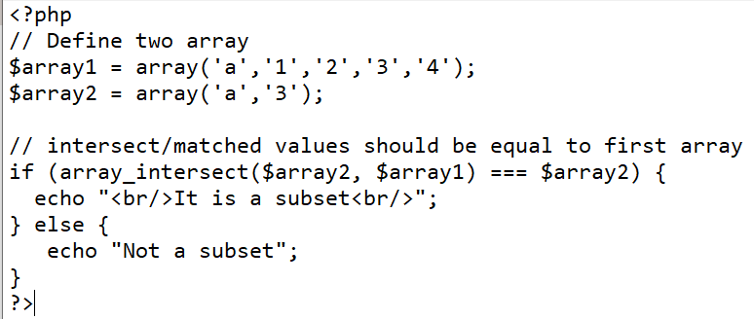
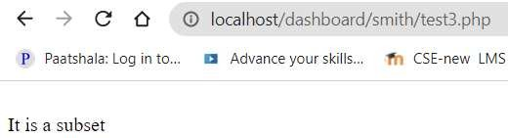

Slide 136
PHP Program to check whether an array is empty or not
An empty array can sometimes cause software crash or unexpected outputs.
To avoid this, it is better to check whether an array is empty or not .
There are various methods and functions available in PHP to check whether the defined or given array is an empty or not.

Slide 137


Slide 138


Slide 139
MultiDimensional Arrays
The first two types of arrays hold strings and integers, whereas this third type holds other arrays.
If each set of key/value pairs constitutes a dimension, a multidimensional array holds more than one series of these key/value pairs.
The $characters array is initialized using the array() function. $characters[0], $characters[1]...

Slide 140
Each element consists of an associative array, itself containing four elements: name, occupation, age, and special_power
echo $characters[1]['occupation’]; will display “superhero”

Slide 141


Slide 142

Multidimensional arrays

Slide 143


Slide 144
Functions
Besides the built-in PHP functions, it is possible to create your own functions.
A function is a block of statements that can be used repeatedly in a program.
A function will not execute automatically when a page loads.
A function will be executed by a call to the function.
A user-defined function declaration starts with the word function.

Slide 145
A function name must start with a letter or an underscore.
Function names are NOT case-sensitive.
They are case-insensitive for the ASCII characters A to Z
All functions and classes in PHP have the global scope - they can be called outside a function even if they were defined inside and vice versa.
PHP does not support function overloading, nor is it possible to undefine or redefine previously-declared functions.

Slide 146
Cntd…
A function is a self-contained block of code that can be called by your scripts.
When called, the function’s code is executed and performs a particular task.
You can pass values to a function, which then uses the values appropriately— storing them, transforming them, displaying them, or whatever the function is told to do.

Slide 147
When finished, a function can also pass a value back to the original code that called it into action.
Functions come in two flavors: those built in to the language and those you define yourself.
PHP has hundreds of built-in functions.
strtoupper() returns a string value, so its usage requires the presence of a variable to accept the new string, such as the following

Slide 148



Slide 149
PHP supports user-defined functions
The general form of a PHP function definition is as follows: function name( [parameters] ) { }
Function names are not case sensitive.
So, you cannot have a function named sum and another named Sum.
the parameters in the call to a function actual parameters.
the parameters that are listed in the function definition formal parameters.

Slide 150
The number of actual parameters in a call to a function does not need to match the number of formal parameters defined in that function.
If there are too few actual parameters in a call, the corresponding formal parameters will be unbound variables.
If there are too many actual parameters, the excess parameters will be ignored.

Slide 151
The default scope of a variable defined in a function is local.
If a variable defined in a function has the same name as a variable used outside the function, there is no interference between the two.
A local variable is visible only in the function in which it is used
PHP has the global declaration.
When a variable is listed in a global declaration in a function, that variable is expected to be defined outside the function.
So, such a variable has the same meaning inside the function as outside.

Slide 152
The default (that is, when storage for it is allolifetime of local variables in a PHP function is from the time the variable is first usedcated) until the function's execution terminates.
The lifetime of a static variable in a function begins when the variable is first used in the first execution of the function.
Its lifetime ends when the script execution ends.

Slide 153


Slide 154



Slide 155
PHP is a Loosely Typed Language
PHP automatically associates a data type to the variable, depending on its value.
Since the data types are not set in a strict sense, you can do things like adding a string to an integer without causing an error.

Slide 156


Slide 157
In PHP 7, type declarations were added.
This gives us an option to specify the expected data type when declaring a function, and by adding the strict declaration, it will throw a "Fatal Error" if the data type mismatches.

Slide 158
To specify strict we need to set declare(strict_types=1);.
This must be on the very first line of the PHP file.
In the following example we try to send both a number and a string to the function, but here we have added the strict declaration: it will throw a "Fatal Error" if the data type mismatches

Slide 159



Slide 160



Slide 161



Slide 162
PHP 7 also supports Type Declarations for the return statement.
Like with the type declaration for function arguments, by enabling the strict requirement, it will throw a "Fatal Error" on a type mismatch.
To declare a type for the function return, add a colon ( : ) and the type right before the opening curly ( { )bracket when declaring the function.

Slide 163


Slide 164


Slide 165
Default parameter-passing mechanism of PHP is pass by value.
The values of actual parameters are copied into the memory locations associated with the corresponding formal parameters in the called function.
The values of the formal parameters are never copied back to the caller, so passing by value a one-way communication to the function.

Slide 166


Slide 167


Slide 168
Pass-by-reference parameters can be done in PHP in two ways.
One way is to add an ampersand (&) to the beginning of the name of the formal parameter that you want to be passed by reference.
The other way is to add an ampersand to the actual parameter in the function call.

Slide 169
In PHP, arguments are usually passed by value, which means that a copy of the value is used in the function and the variable that was passed into the function cannot be changed

Slide 170



Slide 171
Objects
An object is a sort of theoretical box of things—variables, functions, and so forth—that exists in a templated structure called a class.
Think of an object as a little box with inputs and outputs on either side of it.
The input mechanisms are methods, and methods have properties.
An object exists as a data structure, and a definition of that structure called a class.
In each class, you define a set of characteristics.

Slide 172
For example, suppose you have created an automobile class.
In the automobile class, you might have color, make, and model characteristics
Each automobile object uses all the characteristics, but each object initializes the characteristics to different values, such as blue, Jeep, and Renegade, or red, Porsche, and Boxster.

Slide 173

Creating object is so simple

Slide 174
Create an instance of class as:
Create an instance of class as:

Slide 175


Slide 176
Properties of Objects
The variables declared inside an object are called properties.
These properties can be values, arrays, or even other objects.
If you use the keyword public, protected, or private before the variable name, you can indicate if the class member (the variable) can be accessed everywhere (public), within the class itself or a parent class or an inherited class (protected), or only by the class itself (private) :

Slide 177


Slide 178


Slide 179


Slide 180
Object Methods
Methods add functionality to your objects
The -> operator is used to call the object method in the context of your script.
Had there been any variables stored in the object, the method would have been capable of accessing them for its own purposes

Slide 181


Slide 182


Slide 183
The special variable $this is used to refer to the currently instantiated object.
Any time an object refers to itself, you must use the $this variable.
Using the $this variable in conjunction with the -> operator enables you to access any property or method in a class, within the class itself

Slide 184

Changing the value of a property from within a method

Slide 185
when the sayHello() function is called and it looks for $this->name, it uses Julie, which is the new value that was just set by the setName() function

Slide 186
Constructors
A constructor is a function that lives within a class and, given the same name as the class, is automatically called when a new instance of the class is created using new classname.
Using constructors enables you to provide arguments to your class, which will then be processed immediately when the class is called.
A constructor allows you to initialize an object's properties upon creation of the object.
If you create a construct() function, PHP will automatically call this function when you create an object from a class.

Slide 187


Slide 188
Object Inheritance
One class inherits functionality from its parent class

Slide 189


Slide 190


Slide 191
String Comparisons
Many string-processing tasks can be accomplished by using the equality and comparison operators,
function strcmp to compare two strings.
The function returns -1 if the first string alphabetically precedes the second string, 0 if the strings are equal, and 1 if the first string alphabetically follows the second.

Slide 192
Relational operators (==, !=, <=, > and >=) can also be used to compare strings

Slide 193


Slide 194


Slide 195
PHP can process text easily and efficiently, enabling straightforward searching,substitution, extraction and concatenation of strings.
Text manipulation is usually done with regular expressions—a series of characters that serve as pattern-matching templates (or search criteria) in strings, text files and databases.
A regular expression is a sequence of characters that forms a search pattern.
When you search for data in a text, you can use this search pattern to describe what you are searching for.

Slide 196
A pattern is a sequence of characters to be searched for in a character string.
In PHP, patterns are normally enclosed in slash characters.
/def/ T- represents the pattern def.
If the pattern is found, a match occurs.
For example, if you search the string redefine for the pattern /def/, the pattern matches the third, fourth, and fifth characters

Slide 197
String Processing with Regular Expressions
PHP includes two different kinds of string pattern matching using regular expressions:
one that is based on POSIX regular expressions and one that is based on Perl regular expressions
Function preg_match uses regular expressions to search a string for a specified pattern using Perl-compatible regular expressions (PCRE).
POSIX regular expressions are compiled into PHP
preg_match(regex, str)- Returns a Boolean value
Perl-Compatible Regular Expression (PCRE) library must be compiled before Perl regular expressions can be used
preg_split(regex, str) - Returns an array of the substrings

Slide 198
String Processing with Regular Expressions
The ^ and $ Pattern Anchors
The pattern anchors ^ and $ ensure that the pattern is matched only at the beginning or the end of a string.
For example, the pattern /^def/matches ’def’ only if these are the first three characters in the string.
Similarly, the pattern /def$/ matches ’def ’only if these are the last three characters in the string.
You can combine ^ and $ to force matching of the entire string, as follows:
/^def$/This matches only if the string is def

Slide 199
preg_match function
The preg_match()function takes two parameters, the first of which is the Perl-style regular expression as a string.
The second parameter is the string to be searched

Slide 200


Slide 201


Slide 202
The preg_split function operates on strings but returns an array and uses patterns
preg_split takes two parameters, the first of which is a Perl-style pattern as a string. The second parameter is the string to be split.
For example, consider the following sample code:
$fruit_string = "apple : orange : banana";
$fruits = preg_split("/ : /", $fruit_string);
The array $ fruits now has ( "apple", "orange", "banana").

Slide 203


Slide 204



Slide 205


Slide 206


Slide 207


Slide 208


